Slide 1
Continual Learning with Pre-Trained Models: A Survey Da-Wei Zhou, Hai-Long Sun, Jingyi Ning, Han-Jia Ye, and De-Chuan Zhan National Key Laboratory for Novel Software Technology, Nanjing University School of Artificial Intelligence, Nanjing University

Slide 2
Overview
What is continual learning?
Traditional vs. PTM-based Continual Learning
Three Categories of PTM-based CL Methods
Datasets, benchmarks, and experiments
Results

Slide 3
What is Continual Learning?
Real-world AI systems face streaming data that evolves over time
Need to learn new tasks while retaining knowledge from previous tasks
Catastrophic Forgetting: Learning new tasks erases old knowledge
Learn Task 1 → Learn Task 2 → Learn Task 3 → ...
Remember all previous tasks
✅ Perform well on new tasks
❌ Without access to old training data

Slide 4
Traditional vs. PTM-based Continual Learning
Traditional continual learning: Random Initialization → Train on Task 1 → Train on Task 2 → ...
Starts from scratch with randomly initialized weights
Must learn both how to extract features AND how to classify
PTM-based Continual Learning: Pre-trained Model → Adapt to Task 1 → Adapt to Task 2 → ...
Starts with rich representations from large-scale pre-training
Focus on adapting existing knowledge rather than learning from scratch

Slide 5
Why PTMs are Game-Changers
Built-in generalizability: Already know good visual representations
Efficiency: Lightweight adaptation vs. full retraining
Performance: Better starting point leads to better final results
This study uses ViTs as the PTMs
Pre-training: ImageNet21K (14M+ images, 21K classes)
Architecture: Image patches → Transformer blocks → Features
Model Decomposition: f(x) = W^T φ(x)
X: image patches along with classification tokens (CLS)
φ : embedding function (ViT backbone)

Slide 6
Three Categories of PTM-based CL Methods
Prompt-based methods: like giving context notes to an expert
Idea: Add learnable "prompts" to guide frozen PTM
Key Methods: L2P, DualPrompt, CODA-Prompt, DAP
Representation-based methods: like trusting the expert's existing knowledge
Idea: Use PTM features directly with simple classifiers
Key Methods: SimpleCIL, ADAM, RanPAC, EASE
Model Mixture-Based Methods: like a committee of experts voting together
Idea: Create multiple models and combine their decisions
Key Methods: ESN, HiDe prompt

Slide 7
Prompt-Based Methods - Core Concepts
Normal ViT Input: [CLS] [IMG1] [IMG2] [IMG3] ... [IMG196]
With Prompts: [P1] [P2] [P3] [CLS] [IMG1] [IMG2] ... [IMG196]
Prompts are like “tunable instructions”, small parameters to guide the frozen network
The Catastrophic Forgetting Problem
Single Prompt Approach:
Task 1: Update prompts for cats/dogs
Task 2: Update same prompts for cars → Forgets cats/dogs!
Task 3: Update same prompts for flowers → Forgets everything!

Slide 8
Prompt-Based Methods - Core Concepts
The Catastrophic Forgetting Problem
Single Prompt Approach:
Task 1: Update prompts for cats/dogs
Task 2: Update same prompts for cars → Forgets cats/dogs!
Task 3: Update same prompts for flowers → Forgets everything!
Solution: Prompt Pool Strategy
Create multiple prompts: P = {P₁, P₂, ..., P_M}
Learn to select: Which prompt(s) to use for each task?
Key challenge: Prompt selection becomes the bottleneck

Slide 9
Prompt-Based Methods - Key Approaches
L2P (Learning to Prompt) - Foundation Method
Prompt Pool: {(key₁, prompt₁), (key₂, prompt₂), ..., (keyₘ, promptₘ)}
Selection: Find keys most similar to input features
Process: Extract features → Match with keys → Use corresponding prompts
Training: EM algorithm - select prompts, then update them
DualPrompt - Shared vs. Specialized Knowledge
General Prompts: Shared across all tasks (common visual patterns)
Expert Prompts: Task-specific knowledge (one per task)
Insight: Some knowledge should be shared, some specialized

Slide 10
Prompt-Based Methods - Key Approaches
CODA-Prompt - Soft Combination
Innovation: Instead of hard selection, use attention weights
Process: Create weighted combination of multiple prompts
Formula: Final_Prompt = Σ(attention_weight_i × Prompt_i)
DAP - Dynamic Generation
Most Advanced: Generate new prompts for each input using neural networks
Training: train the network that creates the prompt rather than the prompts

Slide 11
Representation-Based Methods - Detailed Look
Simple CIL: Basic nearest-centroid classifier, surprisingly good
def SimpleCIL(task_data):
frozen_features = pretrained_vit(task_data)
for each_class:
prototype = average(frozen_features[class])
classifier_weight[class] = prototype
def classify(test_image):
test_feature = pretrained_vit(test_image)
return cosine_similarity(test_feature, all_prototypes)

Slide 12
Representation-Based Methods - Detailed Look
ADAM (Adaptive aggregation of PTMs) - Best of Both Worlds:
Features = [Frozen_PTM_Features + Fine-tuned_PTM_Features]
Prototype = Average(concatenated_features)
RanPAC (Random Proj. and PTM for CL) - Statistical Enhancement:
Problem: Class prototypes can be correlated
Solution: Random projection + online LDA for better separability

Slide 13
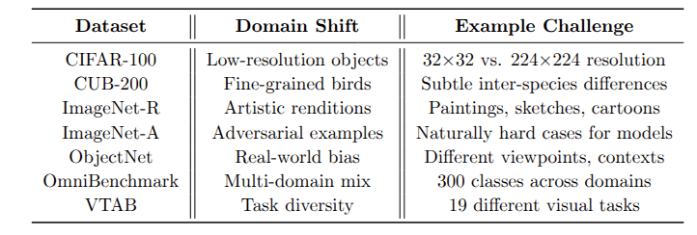
Datasets and Experiment Design
The paper uses datasets with large domain shifts from ImageNet
ViT-B/16-IN21K for all methods
Metrics:
A_B (Last Accuracy): Final performance after all tasks
Ā (Average Accuracy): Mean across all learning stages
Both Important:
- A_B shows final capability
- Ā shows learning stability

Slide 14
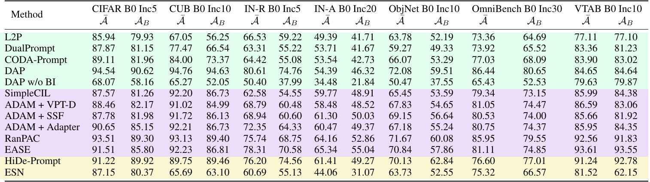
Results

